Slide 1
A highly biased view of WGS analysis
Anthony Fodor
4/15/2024

Slide 2
16S vs. WGS
WGS taxonomic classification is challenging
Low biomass sampling is challenging
Review of a deeply flawed low-abundance microbiome analysis
Some hand-on analysis with and without chat GPT

Slide 3
To download…
Dataset:
https://drive.google.com/file/d/1_WJ5He-frsji1YkdRg5lvdAJVtL52pH9/view?usp=drive_link
(April 1st --→ streamMicrobiome FastQ -→ stream_abundance_table_genus.txt
If you don’t have R installed on your computer:
https://www.r-project.org/

Slide 4
However, this will not be (too much) of a hands on presentation…
Last time, we covered normalization, PCoA and basic statistical models
(and some advice on generating these models in R with ChatGPT).
https://charlotte-edu.zoom.us/rec/share/-3HH3ILBj-6Kvu9J3Dg6WkRb7rk9lR03yraoOpFZi19-tNvrJvOgi0_CqWMqdRgY.t2--D95ZMuzdbX98
Passcode: 7&fdSSEn
Recording Summary
This meeting covered various aspects of microbiome data analysis, including normalization techniques, the use of AI tools like ChatGPT for
data processing and visualization, and statistical methods for interpreting results. The discussion emphasized the importance of
understanding statistical assumptions, careful data visualization, and critical thinking when using AI-generated code or results.
The session concluded with recommendations for learning resources and encouragement for participants to continue
exploring and asking questions in the field of bioinformatics and data analysis.

Slide 5
16S vs. WGS

Slide 6
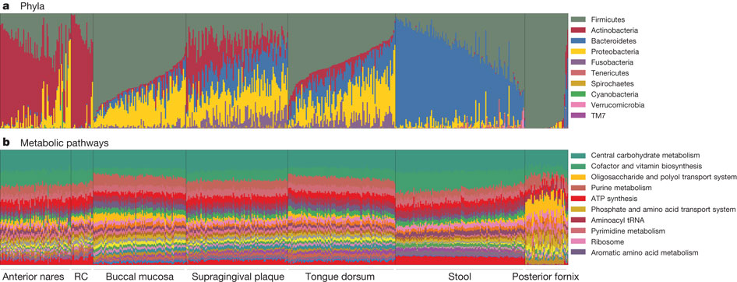
WGS obviously gives function as well as taxonomy
C Huttenhower et al. Nature 486, 207-214 (2012) doi:10.1038/nature11234

Slide 7
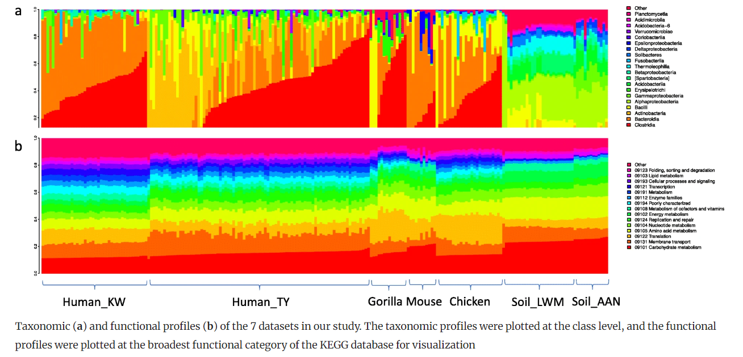
Consistent pathways can be observed beyond the human microbiome
Sun et al. Inference-based accuracy of metagenome prediction tools varies across sample types and functional categories.
Microbiome, 2020

Slide 8
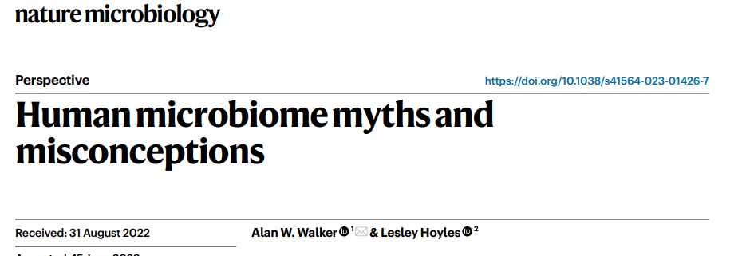
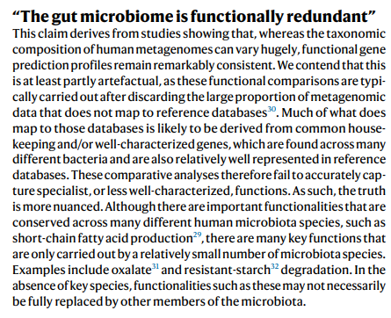
The conclusion that function is more consistent than taxonomy has been controversial…
This reflects one of the challenges of WGS sequencing:
many reads will be unmapped to functional databases.
As we will see, taxonomic classification is also more
challenging on WGS than 16S

Slide 9
Can you predict WGS function just from 16S?
Probably Not

Slide 10
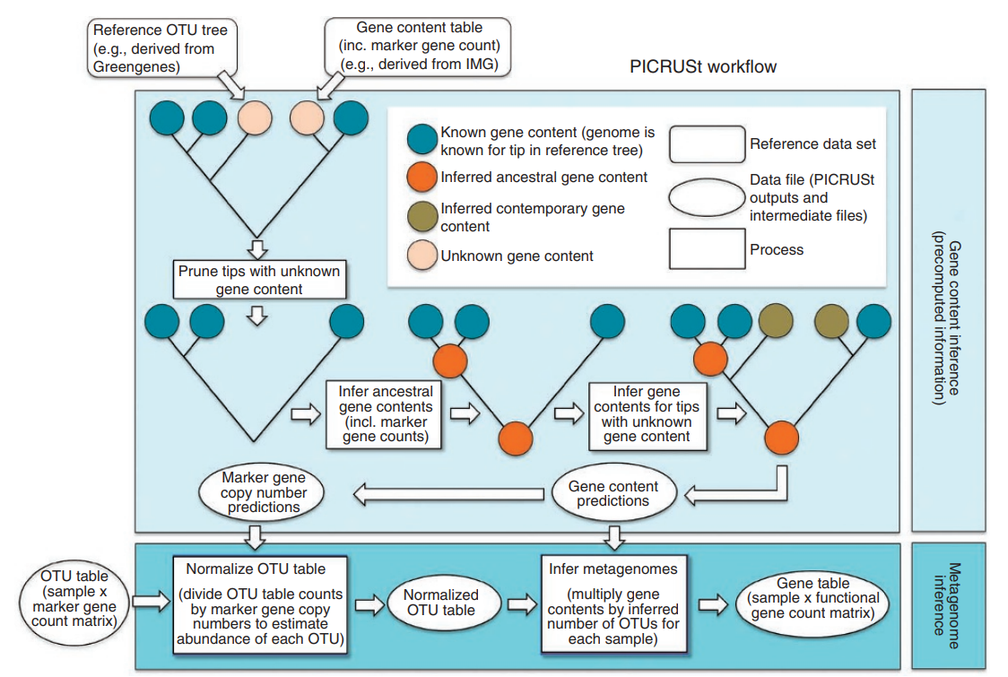
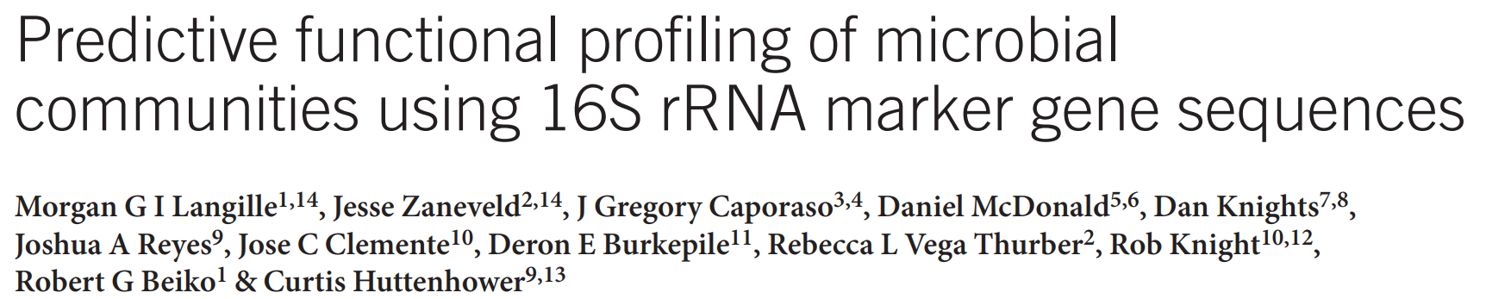

Slide 11
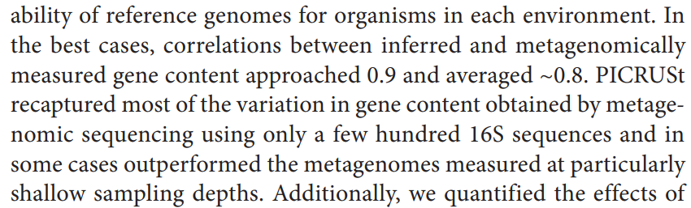
The evidence that these algorithms work initially rely on correlations between predictions from
16S and actual WGS data
But given the uniformity of predictions across all samples, this is problematic…

Slide 12
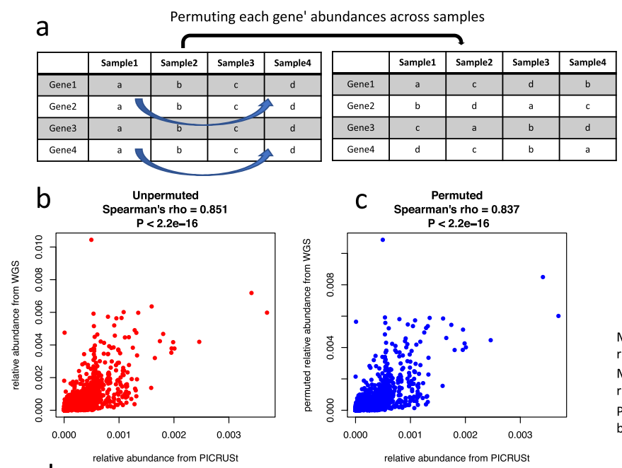
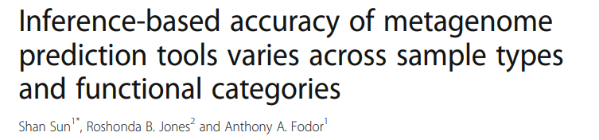
The high correlation between 16S and WGS function is replicated even when randomizing samples

Slide 13
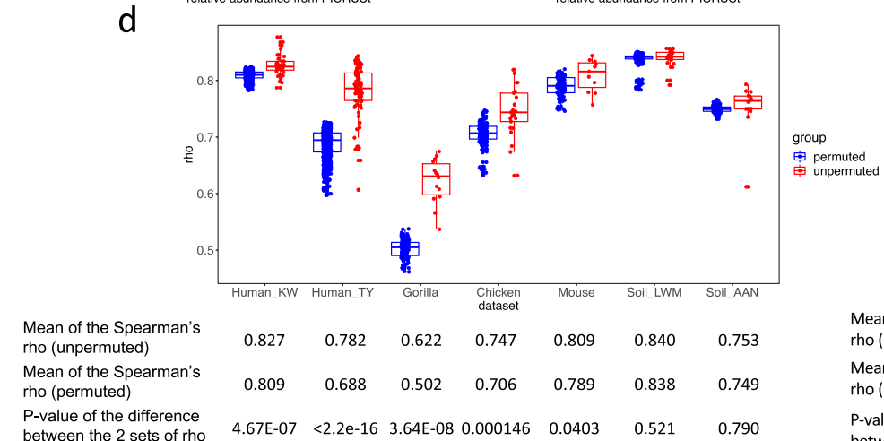
The high correlation between 16S and WGS function is largely replicated even when randomizing samples

Slide 14
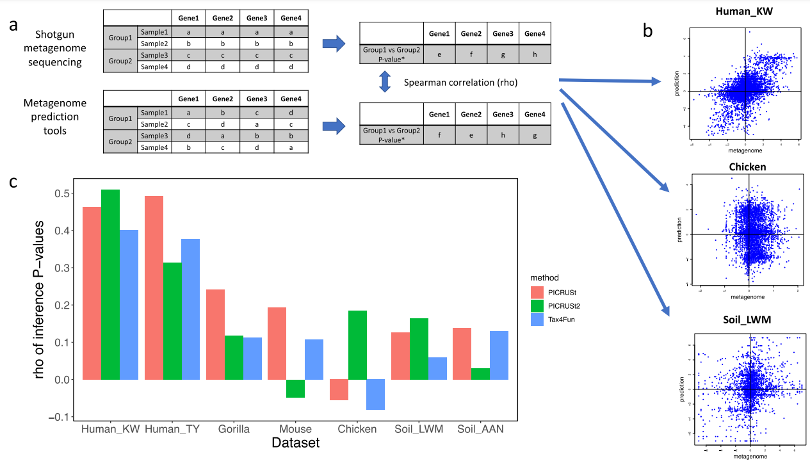
In inference space, the performance of PiCrust is not great anywhere, but is best in humans.

Slide 15
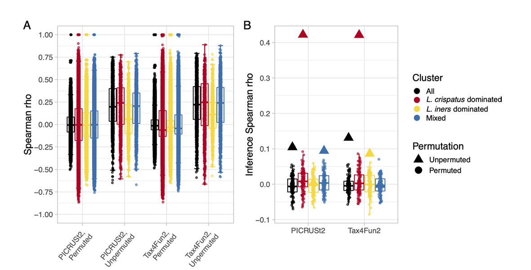
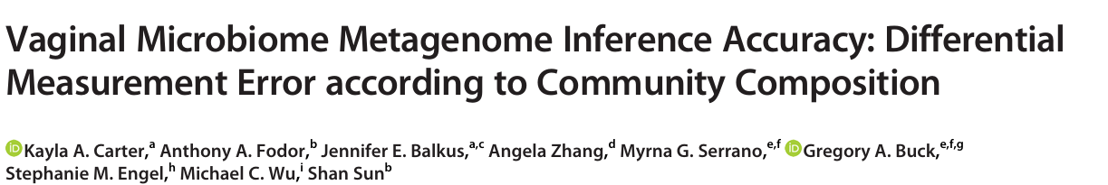
This inference also largely fails for samples outside the human gut

Slide 16
Can you predict WGS function just from 16S?
Probably Not (especially for built environment datasets)

Slide 17
Should I still consider 16S sequence data?
Possibly

Slide 18
WGS gives functional data
WGS can (at least in theory) allow for species/strain resolution on high abundance taxa
WGS can allow for at least partial assembly of genomes from high abundance taxa
These are significant and important advantages of WGS
BUT…
WGS sequence datasets require a lot of disk space and analysis time relative to 16S.
Disk space and analysis time are often a “hidden” cost not considered in the experimental design.
Taxonomic classification of WGS sequences is not (yet) a fully solved problem
Getting functional classification is slow, arduous and often doesn’t classify the majority of sequences
WGS is very challenging on low abundance samples. There are published studies that have successfully
used 16S on the built environment, there seems to be fewer successful WGS examples (but let me know
If you have found papers you think are convincing!).
WGS is often more expensive. Effect sizes are small in most microbiome experiments. Sample size is important.

Slide 19
WGS classification is not yet a solved problem

Slide 20
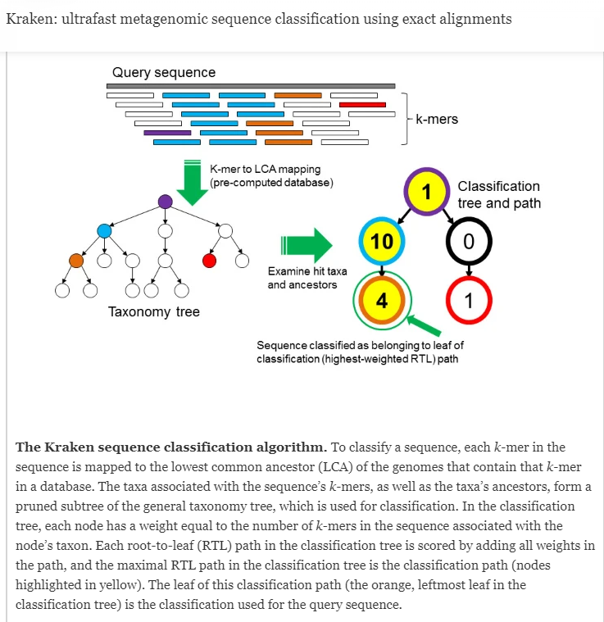
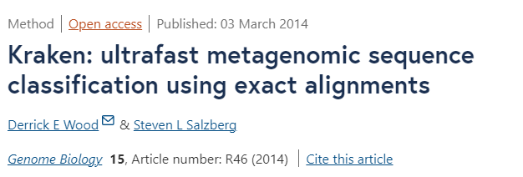

Slide 21
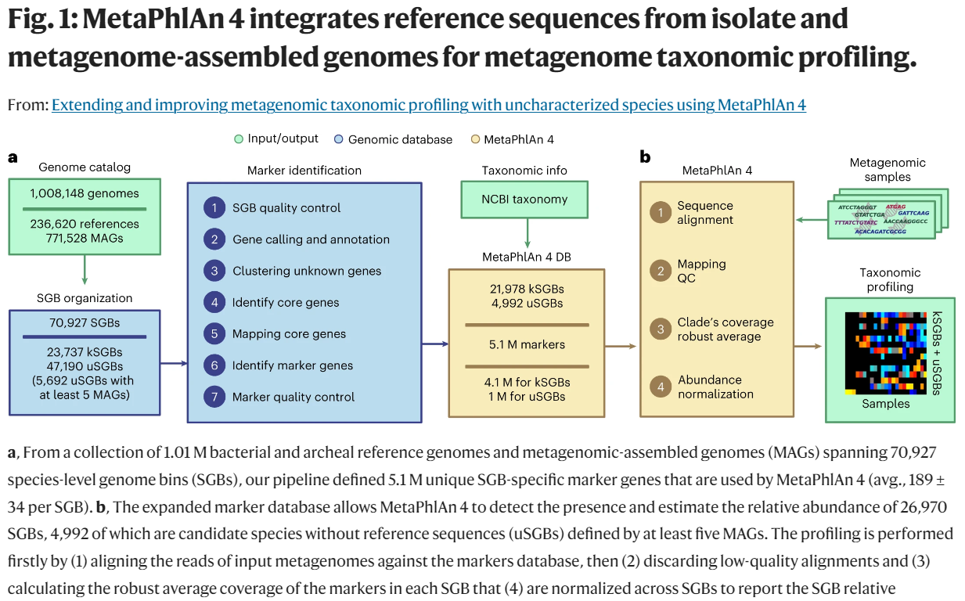

Slide 22
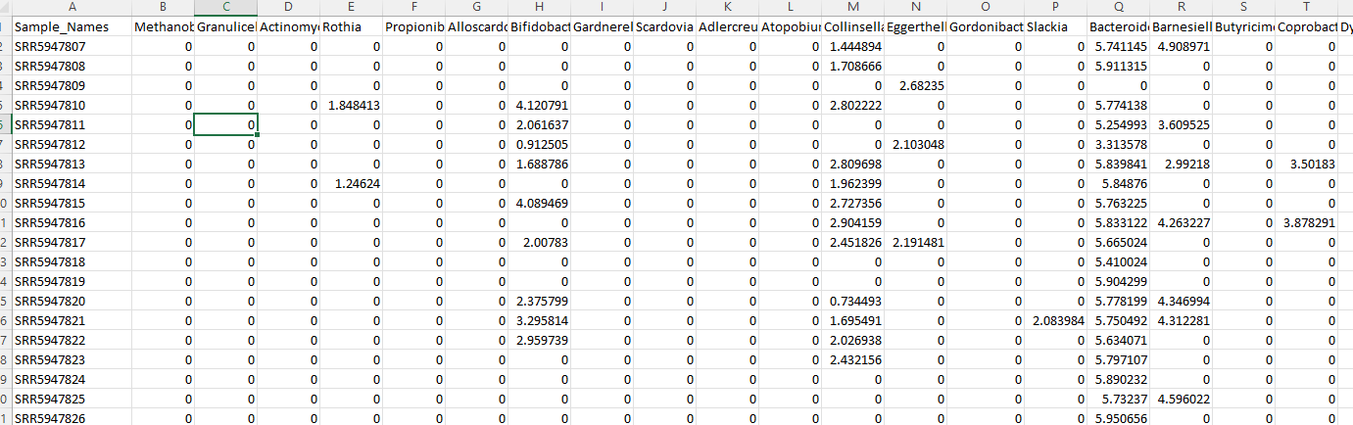
How we view prevalence and richness is very algorithm and method dependent
Metaphlan2 tends to produce very sparse spreadsheets with a few dominant taxa and lots of zeros…

Slide 23
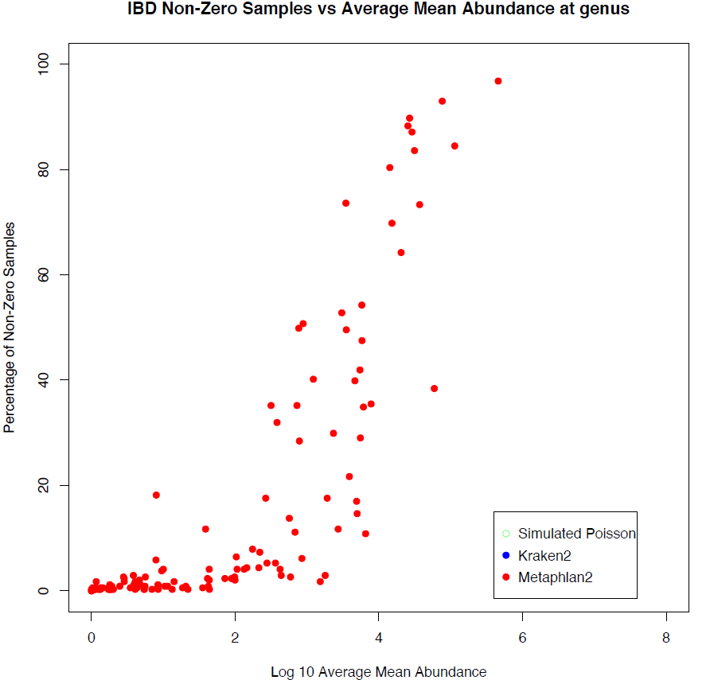
How we view prevalence and richness is very algorithm and method dependent
100
80
60
Percent of non-zero samples
40
20
0
0
2
4
6
8
Log 10 ( abundance )

Slide 24
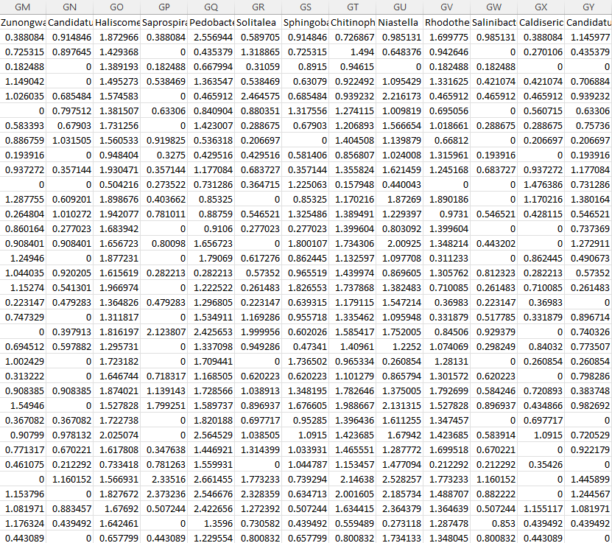
Kraken gives us a much less sparse view of the world…

Slide 25
How we view prevalence and richness is very algorithm and method dependent
100
80
60
Percent of non-zero samples
40
20
0
0
2
4
6
8
Log 10 ( abundance )
Notes:
`

Slide 26
Kraken’s results can be fit by a null model that is unlikely to be explained by biology
100
80
60
Percent of non-zero samples
40
20
0
0
2
4
6
8
Log 10 ( abundance )

Slide 27
Our simplest possible model for classification: “Binomial” or “Poisson” models
You have a very (infinitely) large vat of perfectly mixed ping-pong balls
We model a sequence classification event
(for example, labeling a read represents a sequence variant)
as the probability of randomly drawing red balls from a set of sequences
N – the total number of sequences in a sample (the red balls + the white balls observed)
p – the fraction of all balls in the vat that belong to a variant
If N is large and p is small we say this is a Poisson process.
We draw a 1,000 ping pong balls (sequences) with a “true”
relative abundance of 0.1%, we would expect 1 red ping pong balls.

Slide 28
If N is large and p is small we say this is a Poisson process.
We draw a 1,000 ping pong balls (sequences) with a “true”
relative abundance of 0.1%, we would expect 1 red ping pong balls.
We can produce our expectation under such a null model very easily in a language such as R

Slide 29
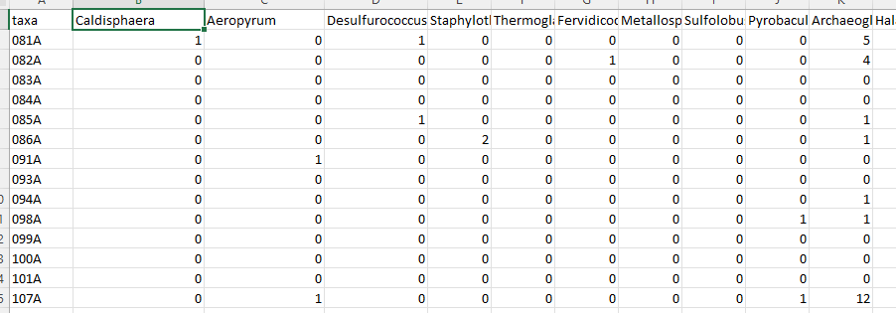
We can generate an entire “simulated” dataset under the Poisson null
Taxa
Samples
Each cell counts how many “red balls” (that taxa) from all the balls in the sample.

Slide 30
Features of a Poisson null model:
No biology (constant background error rate irrespective of sample type of phenotype)
Mean = variance

Slide 31
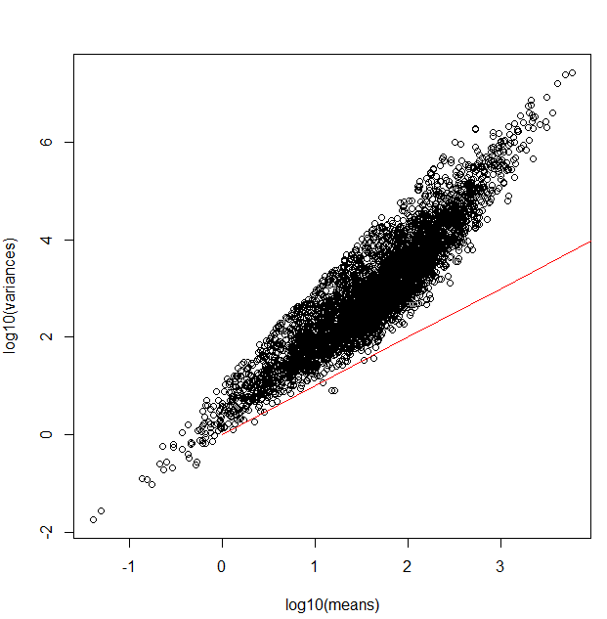
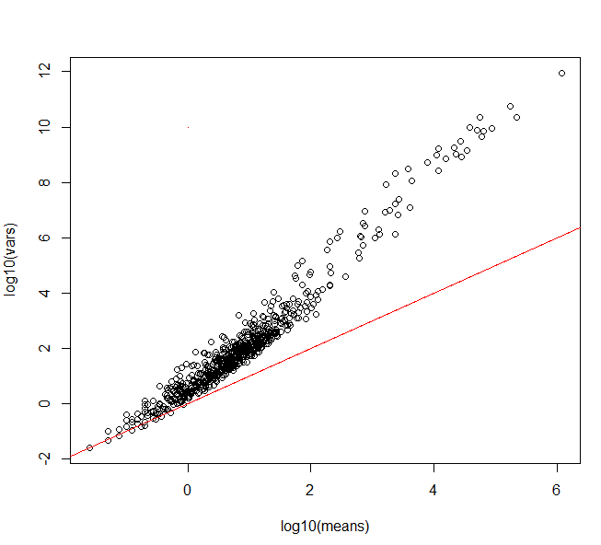
Poisson processes are reliably inadequate for modeling counts tables in genomics experiments
RNA- seq dataset
WGS dataset (through Kraken)
Log10 (variance)
Log10 (variance)
Independent draws across
samples with a constant
relative abundance
Log10 (mean)
Log10 (mean)

Slide 32
Poisson processes are reliably inadequate for modeling counts tables in genomics experiments
RNA- seq dataset
WGS dataset (through Kraken)
Log10 (variance)
Log10 (variance)
Independent draws across
samples with a constant
relative abundance
Log10 (mean)
Log10 (mean)

Slide 33
Poisson processes are reliably inadequate for modeling counts tables in genomics experiments
RNA- seq dataset
WGS dataset (through Kraken)
Log10 (variance)
Log10 (variance)
Independent draws across
samples with a constant
relative abundance
Log10 (mean)
Log10 (mean)

Slide 34
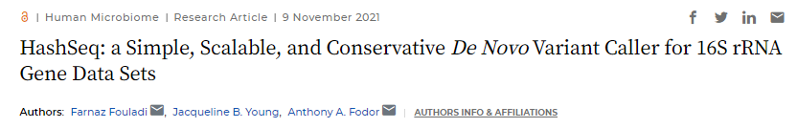



Poisson processes can be surprisingly useful in describing accumulation (richness) of sequence variants
Jack Young
Farnaz Fouladi

Slide 35
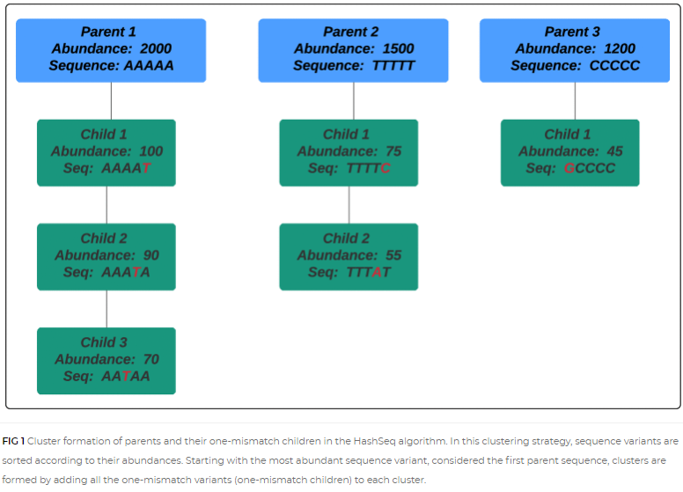
Identify all unique 16S sequences in a dataset.
Sort by abundance – find children (“single mismatch”) variants
https://journals.asm.org/doi/full/10.1128/mSystems.00697-21

Slide 36
Richness is well described across datasets by a simple Poisson process with a constant error rate

Slide 37
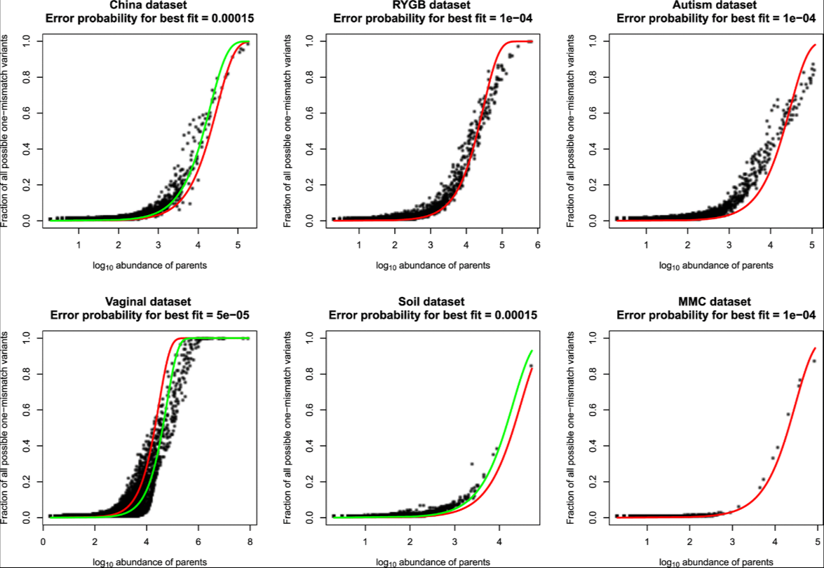
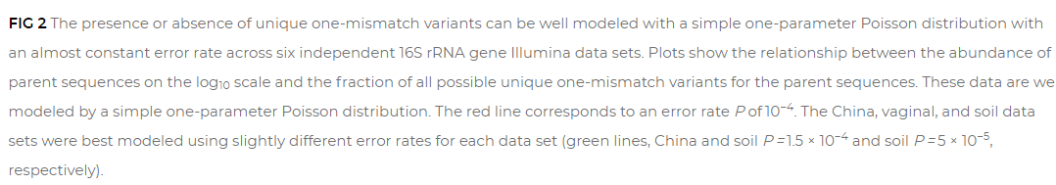
Richness is well described across datasets by a simple Poisson process with a constant error rate
Constant error rate
Best error rate
for that data set

Slide 38
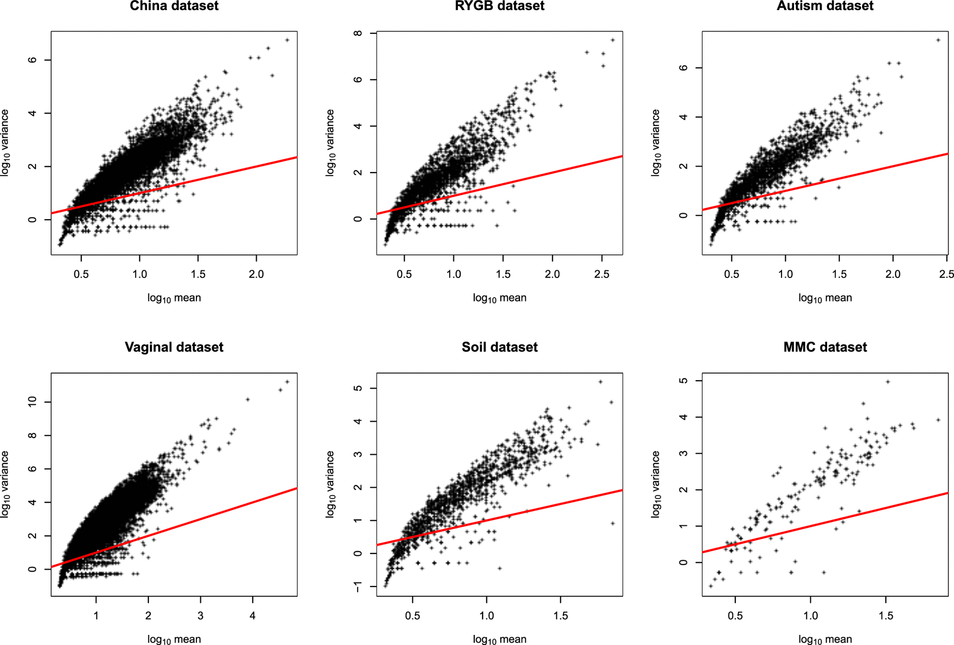
Abundance (as usual) is not well fit by Poisson assumptions

Slide 39
Richness is well described across datasets by a simple Poisson process with a constant error rate
Abundance (as usual) is not well fit by Poisson assumptions
One hypothesis:
In 16S experiments, initial errors accumulate by taq sequencing error (a Poisson process)
The final abundance is dependent on PCR amplification (not a Poisson process)

Slide 40
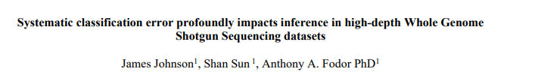


Surprisingly, Poisson algorithms can also be of utility in shotgun sequencing datasets
James Johnson
Shan Sun
Bioarchive (and unpublished!)
https://www.biorxiv.org/content/10.1101/2022.04.04.487034v2.abstract

Slide 41
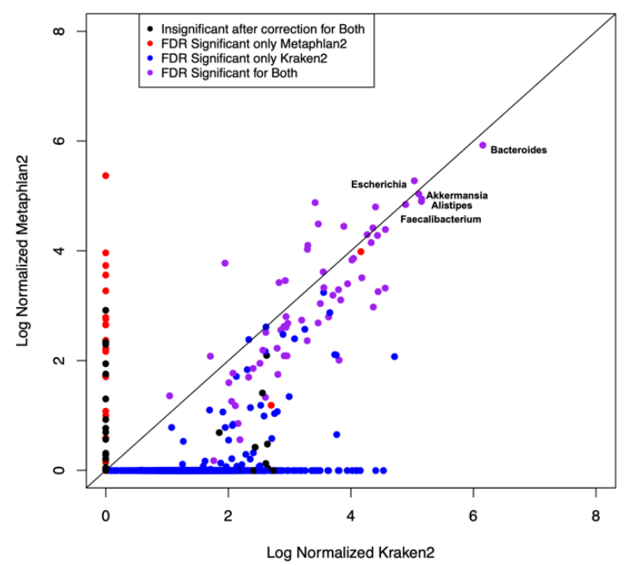
Kraken and Metaphlan agree on high-abundance taxa but not on low-abundance taxa
Kraken finds not only more taxa but more taxa significantly associated with metadata
Inference is case/control
For IBD at a 5% FDR threshold
Log 10 (mean Metaphlan 2)
Log 10 (mean Kraken 2)

Slide 42
Can we evaluate the algorithms even though we don’t know the “correct” answer…
Examine the correlation structure of predictions
Sort all taxa by abundance
1st most abundance – Bacteroides
2nd most abundance – Escherichia
3rd most abundant – Akkermansia
4th most abundant – Alistipes
…
…
For each taxa, report the highest correlation coefficient among all more abundant taxa
So for the 2nd most abundant, this will be the correlation with the 1st most abundance
For the 3rd most abundant, this will be the max( cor(3rd, 2nd), cor(3rd , 1st))
For the 4th most abundance, this be the max( cor(4th, 1st), cor(4th, 2nd), cor(4th, 3rd) )
And so forth…

Slide 43
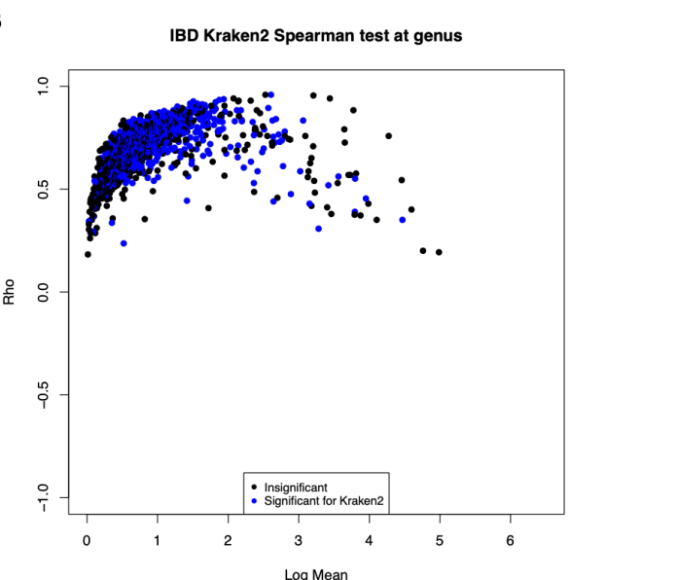
Many of taxa for Kraken are highly correlated with a more abundant “parent” taxa
Rho
Log 10 (mean Kraken 2)

Slide 44
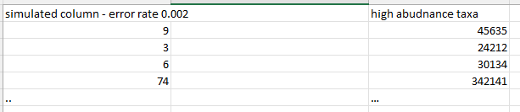
We can model this behavior with a simple Poisson-based procedure with a small # of free parameters
Assume the top 10 taxa are “real”.
Simulate the rest of the dataset as Poisson based sampling error:
for each “simulated” taxa
randomly choose one of
randomly choose an error rate over some range (e.g. 0 < error <= 0.002 )
sum(rpois(45635, lambda = .0002))

Slide 45
We can model this behavior with a simple Poisson-based procedure with a small # of free parameters
Assume the top 10 taxa are “real”.
Simulate the rest of the dataset as Poisson based sampling error:
for each “simulated” taxa
randomly choose one of
randomly choose an error rate over some range (e.g. 0 < error <= 0.002 )
sum(rpois(24212, lambda = .0002))

Slide 46
We can model this behavior with a simple Poisson-based procedure with a small # of free parameters
Assume the top 10 taxa are “real”.
Simulate the rest of the dataset as Poisson based sampling error:
for each “simulated” taxa
randomly choose one of
randomly choose an error rate over some range (e.g. 0 < error <= 0.002 )
sum(rpois(30134, lambda = .0002))

Slide 47
We can model this behavior with a simple Poisson-based procedure with a small # of free parameters
Assume the top 10 taxa are “real”.
Simulate the rest of the dataset as Poisson based sampling error:
for each “simulated” taxa
randomly choose one of
randomly choose an error rate over some range (e.g. 0 < error <= 0.002 )
sum(rpois(342141, lambda = .0002))

Slide 48
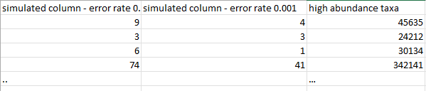
We can model this behavior with a simple Poisson-based procedure with a small # of free parameters
Assume the top 10 taxa are “real”.
Simulate the rest of the dataset as Poisson based sampling error:
for each “simulated” taxa
randomly choose one of
randomly choose an error rate over some range (e.g. 0 < error <= 0.002 )
sum(rpois(45635, lambda = .0001))

Slide 49
We can model this behavior with a simple Poisson-based procedure with a small # of free parameters
Assume the top 10 taxa are “real”.
Simulate the rest of the dataset as Poisson based sampling error:
for each “simulated” taxa
randomly choose one of
randomly choose an error rate over some range (e.g. 0 < error <= 0.002 )
sum(rpois(24212, lambda = .0001))

Slide 50
We can model this behavior with a simple Poisson-based procedure with a small # of free parameters
Assume the top 10 taxa are “real”.
Simulate the rest of the dataset as Poisson based sampling error:
for each “simulated” taxa
randomly choose one of
randomly choose an error rate over some range (e.g. 0 < error <= 0.002 )
sum(rpois(30134, lambda = .0001))

Slide 51
We can model this behavior with a simple Poisson-based procedure with a small # of free parameters
Assume the top 10 taxa are “real”.
Simulate the rest of the dataset as Poisson based sampling error:
for each “simulated” taxa
randomly choose one of
randomly choose an error rate over some range (e.g. 0 < error <= 0.002 )
sum(rpois(342141, lambda = .0001))
In this way we simulate the entire dataset assuming that everything except the
most abundant taxa is Poisson-based classification error of the most abundant taxa

Slide 52
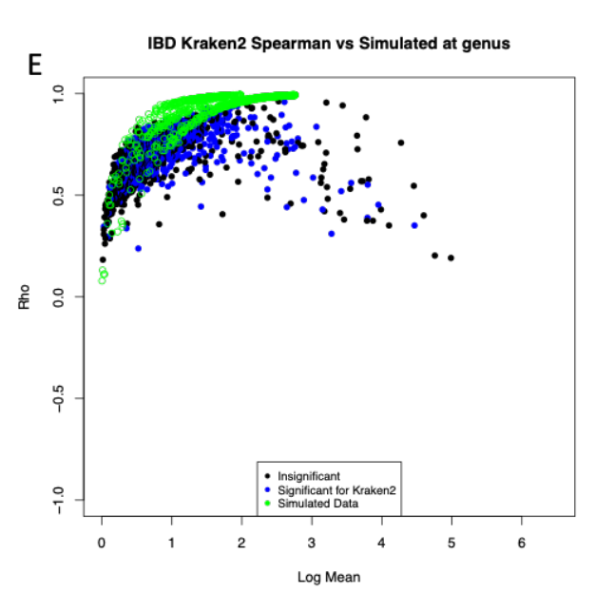
Somewhat remarkably, this simple model captures much of the behavior of low-abundance Kraken taxa
Rho
Log 10 (mean Kraken 2)

Slide 53
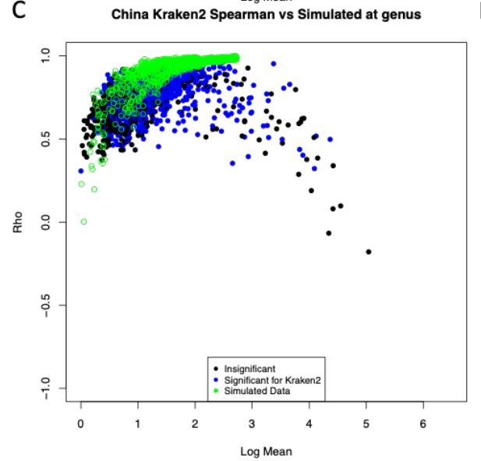
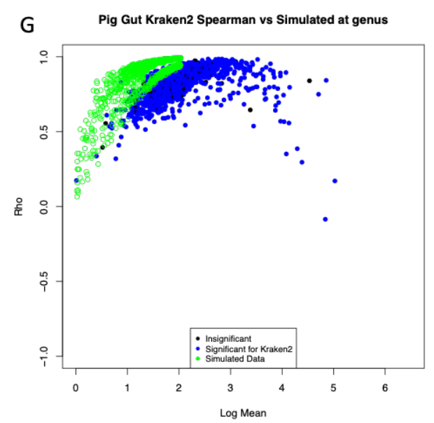
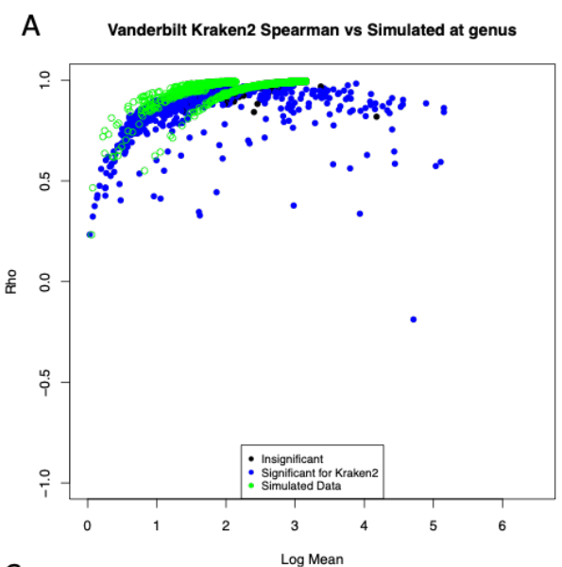
A constant error rate fits three of four datasets very well

Slide 54
We can explain much of the prevalence relationship from Kraken with our Poisson model
(alas, with a different background error rate….)
100
80
60
Percent of non-zero samples
40
20
0
0
2
4
6
8
Log 10 ( abundance )

Slide 55
Mis-classification events from k-mer classifiers of WGS can be well modeled
with a Poisson distribution with no biology in the null model
Spurious correlations can be problematic for network analysis
Low abundance taxa with high correlations to high abundance taxa should be independently confirmed
as being actually present and not “phantom”
Filtering thresholds for WGS datasets should be set from abundance (not prevalence!)
Mis-classification events become more likely as sequencing depth and database density increase!
Error models may allow us to capture background expectations and evaluate null hypotheses
that a given observation of a taxa can be explained by background error rate calculations…
We have such a model for 16S ASVs and are working towards that in WGS
WGS analysis can be inherently more challenging than 16S and popular algorithms have fundamental
disagreements about how to interpret WGS data
A significant result with metadata does not mean the taxon is actually present.

Slide 56
Recommendations for dealing with contaminant issues in
built-environment sampling

Slide 57
Even without contaminants, microbiome sampling is complex…
Issues with compositionality and measurement bias can impact the accuracy of our measurements
(and there is an extensive literature on these issues…)
Contamination is another level of complexity that is especially problematic in low biomass samples
(i.e. most of the sampling we will do in the built environment).
Consider for each taxa (ignoring bias), the “observed” and “actual” values for a taxa
Observed = present in sample + sum( contaminant)
In high biomass samples, the observed will be highly correlated to the observed
In low biomass samples, contaminants may dominate

Slide 58
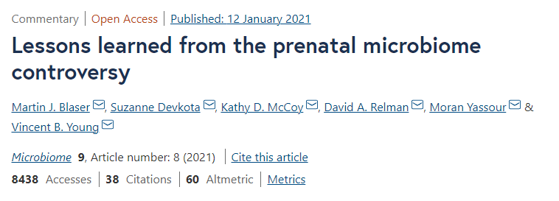
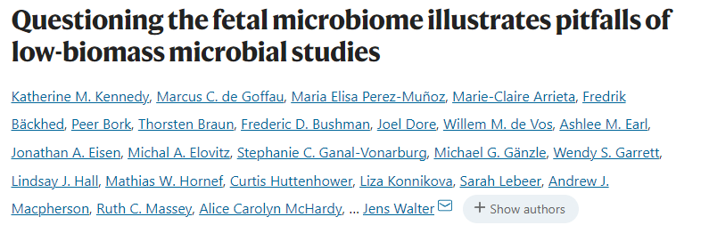
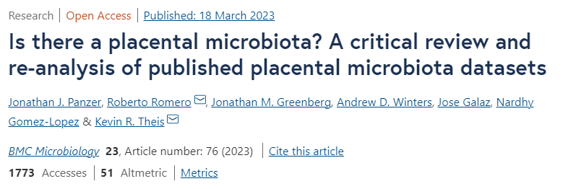
Measuring low abundance microbiome is difficult and can lead to ambiguous results
The “placental microbiome” controversy has consumed a great deal of time and effort
A consensus appears to be emerging that these studies can be largely explained by contaminant
In PreMiEr, we will need very strong evidence for assertions we will make about low biomass environments

Slide 59
Removing contaminants from microbiomes is complex.
There is no simple strategy that will work consistently across different experimental strategies
or even consistently within a single pipeline.
So instead of a simple list of rules to follow that will always “solve” the problem, we are instead
forced to list a series of questions you need to ask about your study you need to think about as
you plan your sampling.
Like so much else in the center, a strategy for contaminant detection in your study will likely be
iterative requiring many cycles of trial and error.
Our goal is compelling evidence that our conclusions cannot be explained by contaminant

Slide 60
Q1: What is the purpose of my experiments?
Am I trying to do biology (where I want to just remove all the contaminants)
or pipeline development (where I want to understand the source of contaminants)?
This impacts the design of your negative controls.

Slide 61
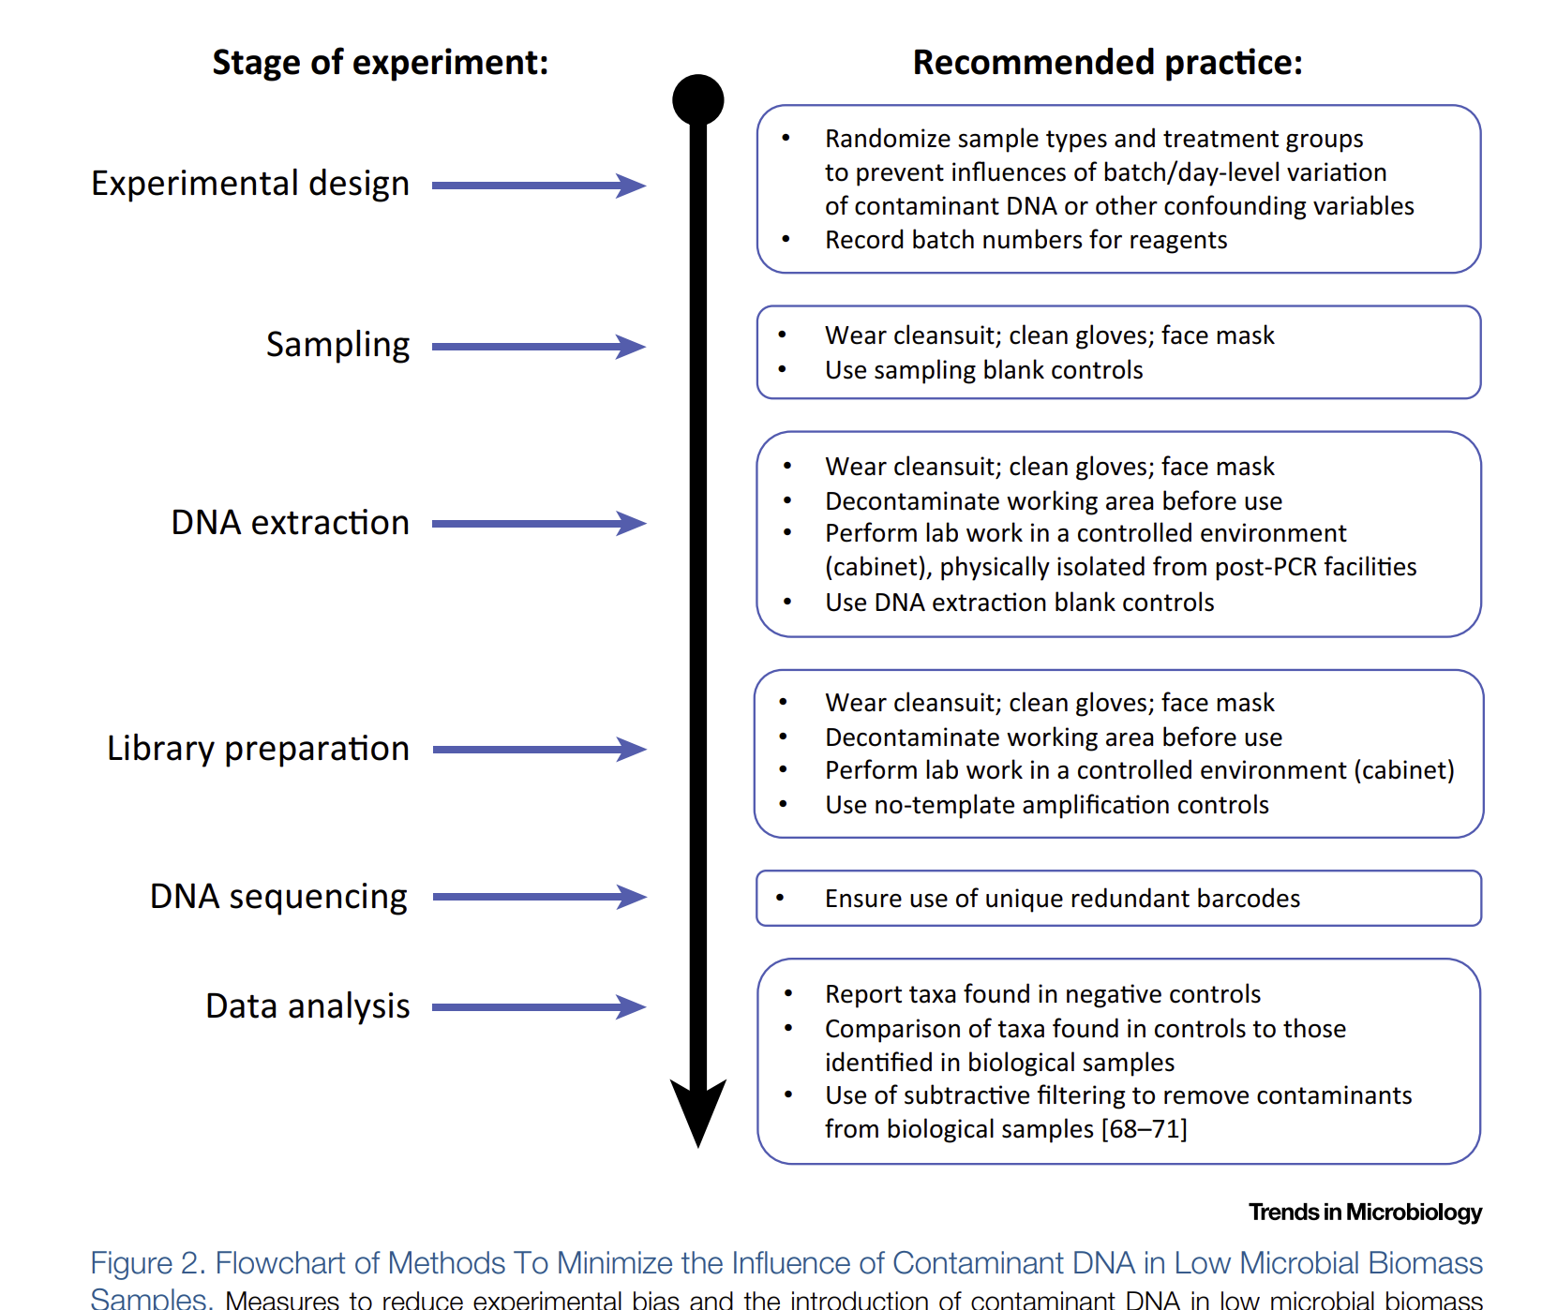
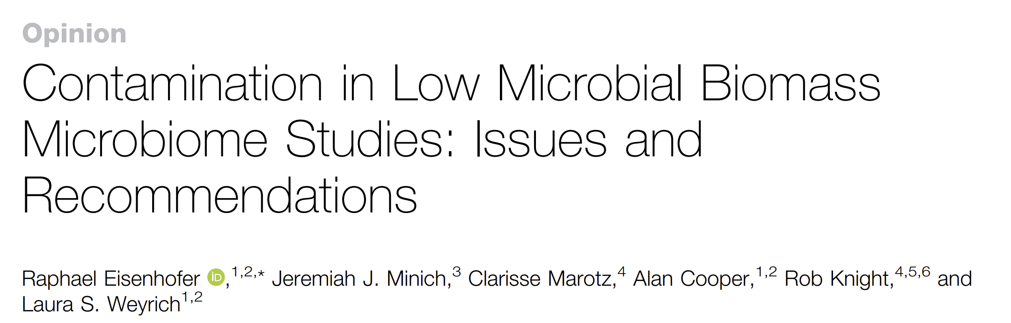
This base document from 2019 is
a good place to start in terms of
wet lab recommendations
Feb 2019

Slide 62
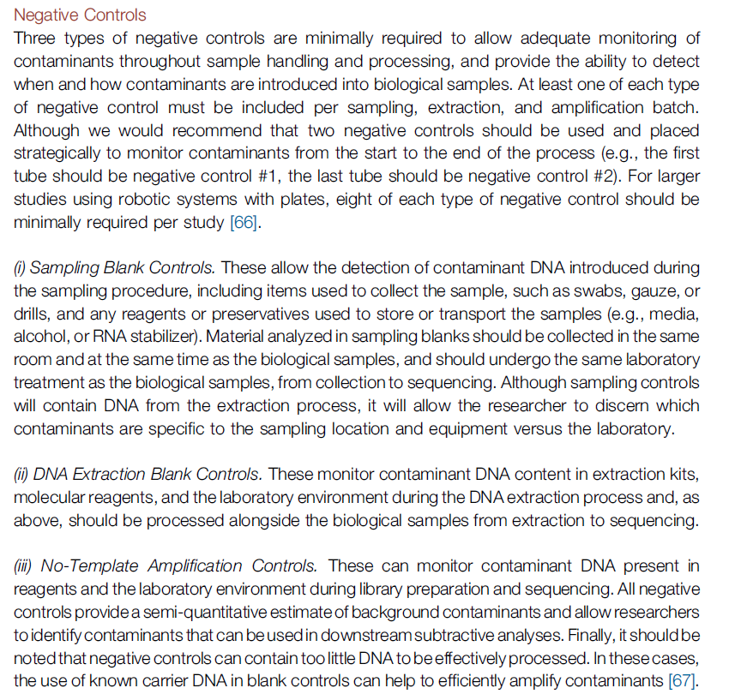
From Dr. Callahan:
Not all controls are created equal.
Controls at the beginning of an experiment
have more power for contaminant detection.
Controls at each step have more power in
resolving the source of a contaminant.

Slide 63
Q1: What is the purpose of my experiments?
Am I trying to do biology (where I want to just remove all the contaminants)
or pipeline development (where I want to understand the source of contaminants)?
This impacts the design of your negative controls.
Q2: How much do I care about establishing the limits of detection and cross-contamination?
This impacts the design of your positive controls.

Slide 64
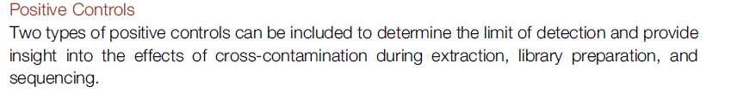
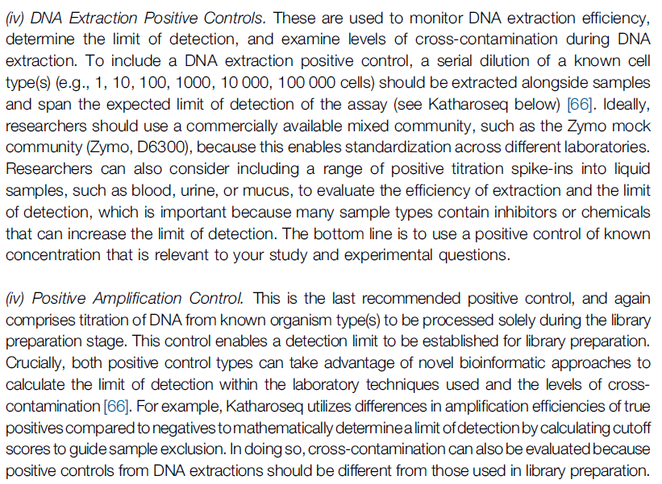
Are positive controls worth
the sequencing effort?
In general, we want to avoid
placing a high-abundance control
in an otherwise low-abundance
pipeline
The “correct” number of positive
controls may be 0-1 for some of our
experiments

Slide 65
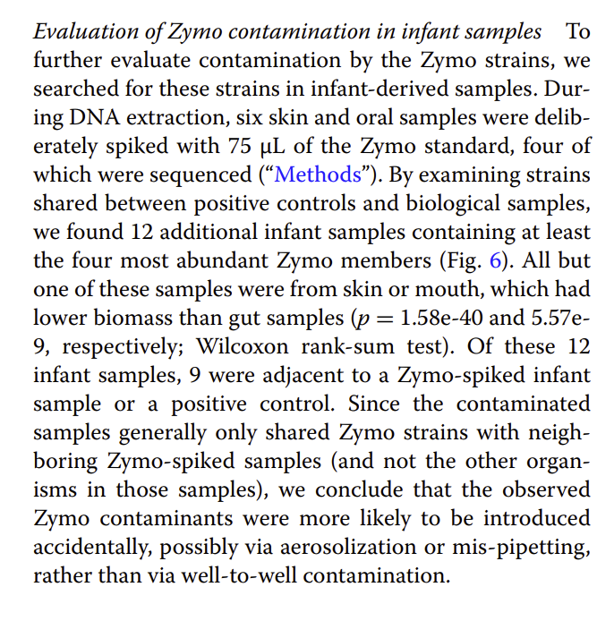
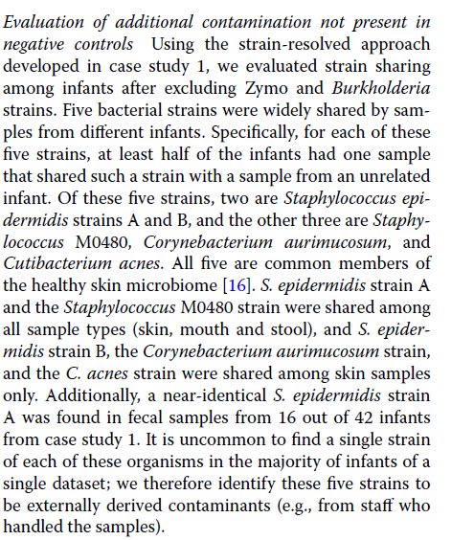
Positive controls and technician skin microbiome are also sources of contaminant in Lou et al

Slide 66
Q1: What is the purpose of my experiments?
Am I trying to do biology (where I want to just remove all the contaminants)
or pipeline development (where I want to understand the source of contaminants)?
This impacts the design of your negative controls.
Q2: How much do I care about establishing the limits of detection and cross-contamination?
This impacts the design of your positive controls.
(I think an argument could be made for a technician skin sample positive control)

Slide 67
Q1: What is the purpose of my experiments?
Am I trying to do biology (where I want to just remove all the contaminants)
or pipeline development (where I want to understand the source of contaminants)?
This impacts the design of your negative controls.
Q2: How much do I care about establishing the limits of detection and cross-contamination?
This impacts the design of your positive controls.
(I think an argument could be made for a technician skin sample positive control)
Q3: How much would cross-contamination of samples complicate interpretation of
experimental results?

Slide 68
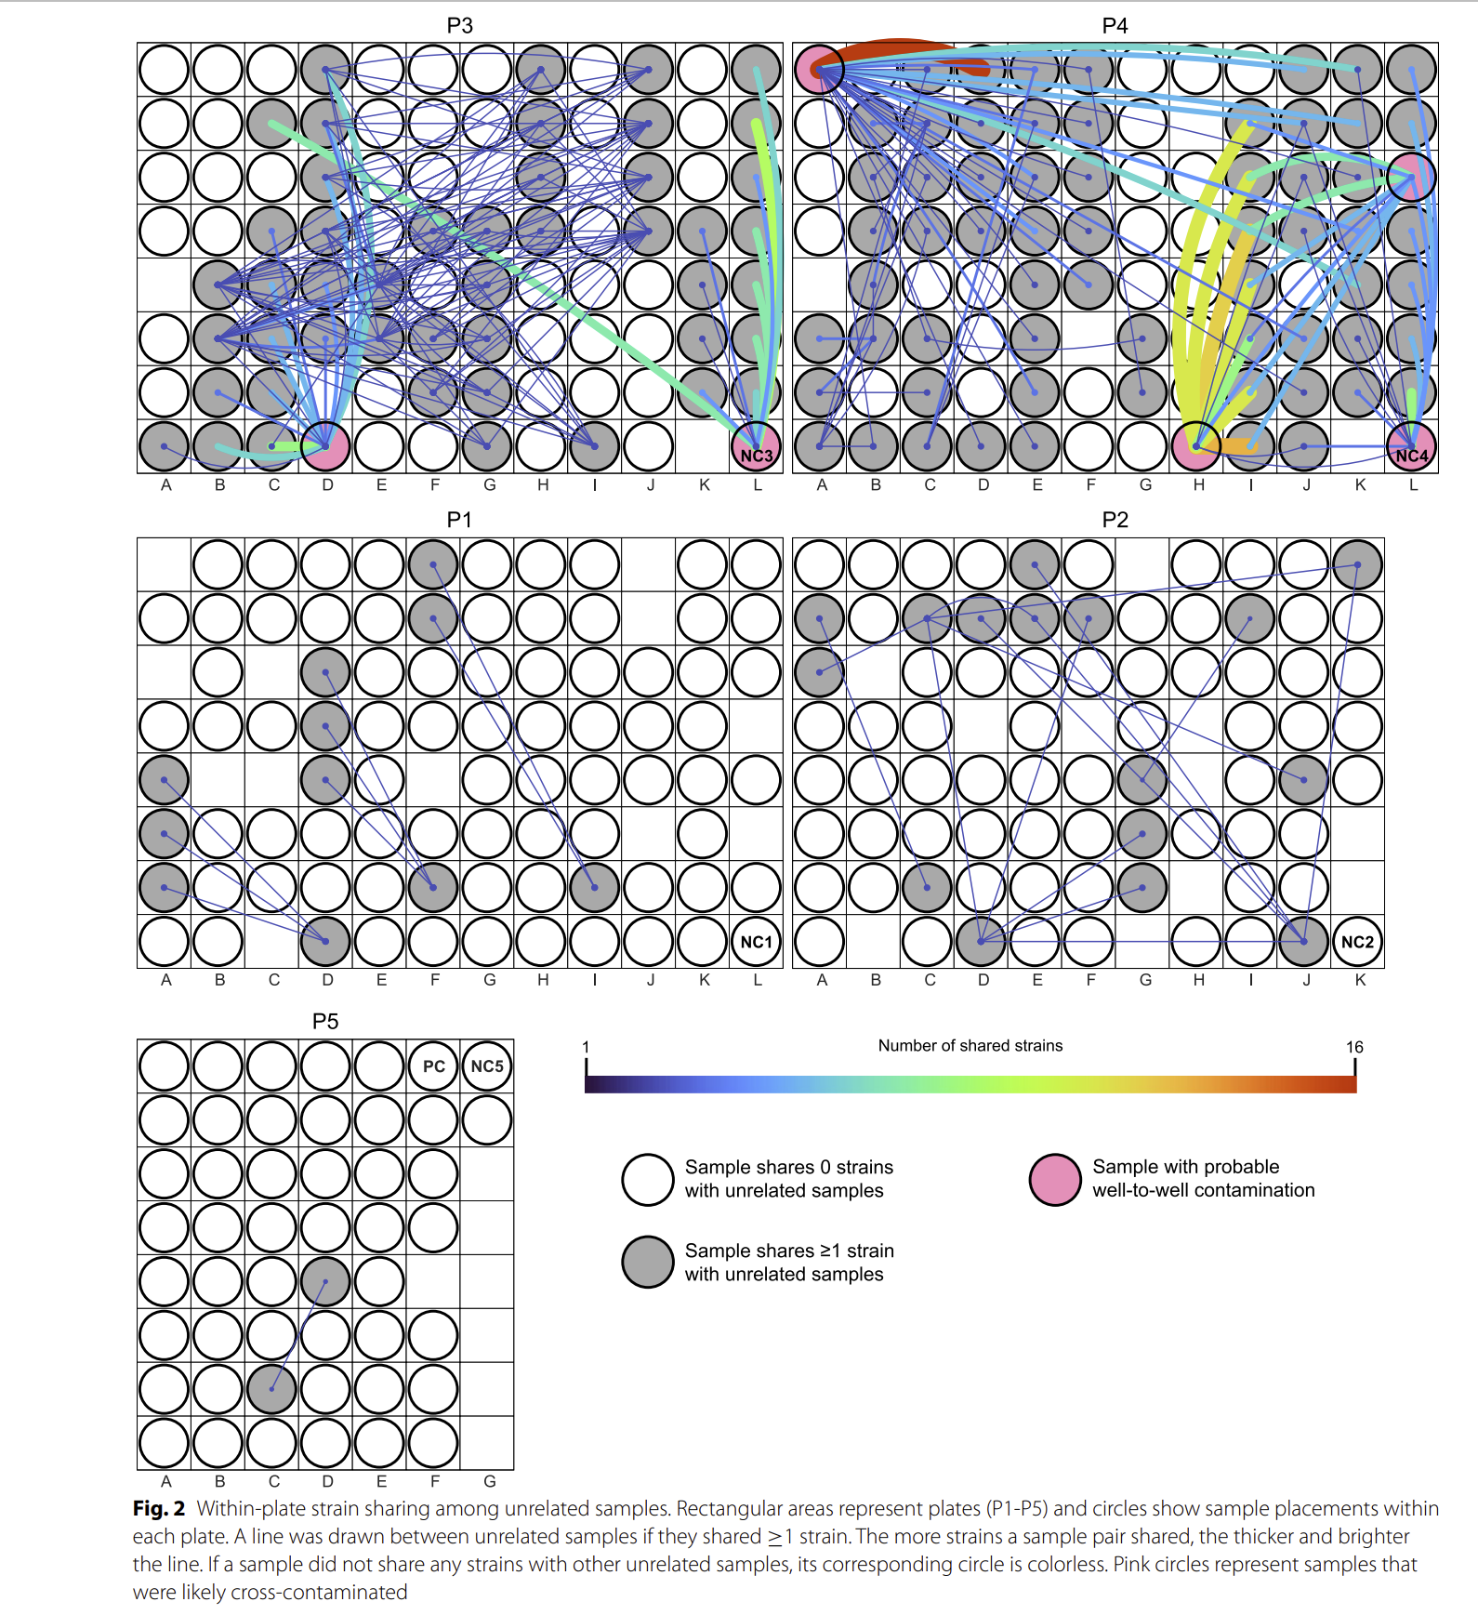
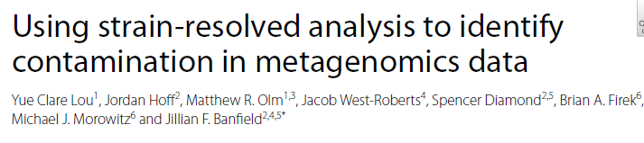
In Lou et al, this is a map describing most likely cross-sample contaminant on 96 well plates
Cross-contamination is widespread,
especially if 96 well plate automation is used.

Slide 69
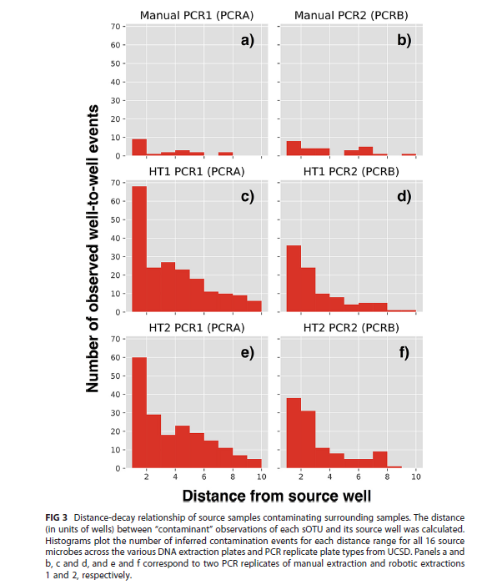
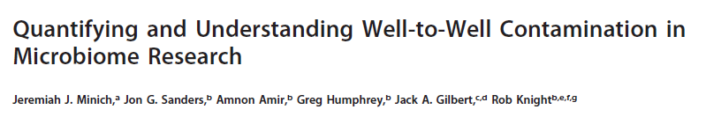
Well to well contamination was explicitly studied in 2019
Manual extraction shows much less well-to-well contamination than high-throughput extraction

Slide 70
Q1: What is the purpose of my experiments?
Am I trying to do biology (where I want to just remove all the contaminants)
or pipeline development (where I want to understand the source of contaminants)?
This impacts the design of your negative controls.
Q2: How much do I care about establishing the limits of detection and cross-contamination?
This impacts the design of your positive controls.
(I think an argument could be made for a technician skin sample positive control)
Q3: How much would cross-contamination of samples complicate interpretation of
experimental results?
Re-extraction of samples from a different randomized context and
avoiding automation may minimize cross-contamination but with obvious costs

Slide 71
Source | Is clearly contaminant | Can be addressed with database searches | Can be solved with long-read requirements | Can be addressed algorithmically | Implications for inference
Non-biological contaminant (e.g. kit contaminant) | Yes. Using a different kit will produce different results. | Probably (especially if a kit has been used in many previous experiments) | Possibly | Possibly (contaminants should be about equally present in all samples irrespective of metadata) | When comparing samples of similar biomass, spurious results are unlikely to be produced.
Biological contaminant (e.g. skin contaminant) | Unclear. If you send a researcher into the built environment, the environment changes. But is that contaminant? Like electrons, measuring the built environment will change the built environment | Possibly (but each person has a distinct skin microbiome!) | No | Possibly (contaminants should be equally present in all samples, but depends on when in the process samples were exposed to human microbiome) | When comparing samples of similar biomass, spurious results are unlikely to be produced.
Cross-samples contaminant | Yes. | No (since each experiment is likely to have unique taxa) | No | Possibly but only if all batch information (including well location) is recorded | Minimal if all blocks (including well) are randomized

Slide 72
Recommendations that are (presumably) not controversial:
Make your lab procedures as clean as possible
Use dual-indexed non redundant bar codes
Measure biomass of samples
Randomize as much as possible across inference categories.
Record all possible batches
(technicians, plate, well position, date of extraction,
sequencing runs, well position)

Slide 73
More “difficult” decisions:
What kind (and how many) negative controls to run.
Obviously, more negative controls for lower biomass samples!

Slide 74

The dataset used for validation of SCRuB is one we should study for how to do low biomass sampling.
They had 811 negative controls for ~1500 samples.
We could consider a similar fraction of effort for negative controls
The human tumor microbiome is composed of tumor type–specific intracellular bacteria. Science. 2020

Slide 75
More “difficult” decisions:
What kind (and how many) negative controls to run.
Obviously, more negative controls for lower biomass samples!
Starting with as much as 0.5 negative controls per sample
and scaling back after initial successes seems reasonable for
ultra-low biomass samples.

Slide 76


This is a convincing pipeline that I argue we could consider as a model….
They used data from 5 different amplicons.
There are pluses and minuses to this approach
in comparison to WGS
The last filter is a multi-center inference filter
The human tumor microbiome is composed of tumor type–specific intracellular bacteria. Science. 2020

Slide 77
More “difficult” decisions:
What kind (and how many) negative controls to run.
Obviously, more negative controls for lower biomass samples!
Starting with as much as 0.5 negative controls per sample
and scaling back after initial successes seems reasonable for
ultra-low biomass samples.
How much to avoid automation to avoid cross contamination?
How much to avoid high abundance samples (including positive controls)?
How much to re-extract across different random contexts
(to minimize cross-contamination)
What kind of sequencing to do? Single amplicon? Multi-amplicon? WGS?

Slide 78
How will we analyze these data?
No “black box” solution that will work for every experiment.
We don’t know what fraction of our built environment samples will be contaminant
(but it will presumably be pretty high).
Algorithms designed for other environments may not work well for our data.

Slide 79

March, 2023

Slide 80

In terms of analytics, SCRuB (published March, 2023) attempts to explicitly model and correct for
sources of contamination
Contamination source modeling with SCRuB improves cancer phenotype prediction from microbiome data.
Nature Biotechnology

Slide 81

SCRuB assumes a constant contaminant
contribution and a variable “signal”,
models everything with the multinomial distribution
And finds parameters by expectation maximization

Slide 82

The authors generate simulated datasets to show off their algorithm
Contamination source modeling with SCRuB improves cancer phenotype prediction from microbiome data.
Nature Biotechnology

Slide 83

But what puts this paper into Nature Biotechnology is this startling result re-analyzing a
(low biomass) tumor experiment (predicting from n=73 from one center to modest n=18 from a different continent)
This is impressive, but this result is dependent
on correct classification of only ~6-8 samples
over competing methods
Contamination source modeling with SCRuB improves cancer phenotype prediction from microbiome data.
Nature Biotechnology

Slide 84

SCRuB does have some limitations. It can only deal with one source of contaminant at a time…
The concluding paragraph
There is room for further analytical development allowing for simultaneous input
of multiple contaminant sources

Slide 85
Areas of future research we should consider for our center:
(1) How robust are the machine learning gains shown by SCRuB?
Can we find other datasets in which removal of contaminant improves ML performance? Or does the fact that SCRuB only shows a dramatic increase
in a validation set with a small sample size suggest that gains in inference and ML
will be modest with contaminant removal.
(If contaminants are properly randomized, inference should be safe)
(2) Can we extend SCRuB to deal with multiple sources of contaminant simultaneously?
How much does the order in which contaminants are removed matter for results?
(3) Using skin and kit microbiome as references together with the expectation
that contaminant will be independent of metadata, how much of existing
public datasets (Sloan Foundation, metaSub, low abundance HMP, other
environmental datasets) can be explained as contaminant?

Slide 87
Microbiome Signatures of Cancer: Fact or Artifact? Navigating a Current Controversy in Microbiome Sciences

Slide 88




(Wall Street journal)
The article describes an initial Knight lab analysis done in this paper which argues
that there is a microbial signature in cancer.
The retracted paper is here: https://www.nature.com/articles/s41586-020-2095-1
The paper was retracted mostly because of an analysis done here https://journals.asm.org/doi/10.1128/mbio.01607-23
But the original authors responded that their first analysis was largely correct here: https://www.nature.com/articles/s41388-024-02974-w

Slide 89

The 2020 retracted paper. >900 citations. ~$20 million of venture (according to WSJ)

Slide 90


Slide 91

Between tumor
types
Between tumor
And normal

Slide 92

Much of the data in all 3 papers is reported as a result of ROC curves…
Is a sample case or control?
Whole-genome metagenome sequencing
on samples with known disease status
Training set
Test set
Find features
(taxa, genes)
that predict status
Build statistical model
Make predictions on test set
Image: http://www.sprawls.org/ppmi2/IMGCHAR/1IMCHAR12.gif
An area under the curve (AUC) of 100 means a perfect classifier
An AUC of 50 is as good as guessing at random

Slide 93
I think this design is inherently flawed:
Different centers
Batch correction algorithm
Machine learning on all samples
as if they came from the same study
If the batch correction algorithm fails to perfectly compensate for signal from different centers,
and different centers have different kinds of cancer, the machine learning algorithm will
produce artifactual results.
(this is presumably (?) what happened in the original paper)
Using different batch correction algorithms does not really fix this problem
(a major problem with the arguments used in the rebuttal paper!)

Slide 94


Even after “correction there is still some residual variation associated with sequencing center.
If sequencing center is associated with caner type, that will be more than enough for a
machine learning algorithm to discover, especially one as “flexible” or “tunable” as
Stochastic-gradient boosting machine learning…

Slide 95


Alternative #1: Leave one study out machine learning approach
Train on all studies but 1 and then test the machine learning model on the left out study
Note that cases and controls have to be in the same study.
You can’t use this approach when cases and controls are from different studies.
Probably when cases and controls are from different studies, you should not attempt a classification analysis!

Slide 96


Alternative #2: P-value vs. p-value plots
Perform inference within each study and compare the results…

Slide 97
There are 2 main criticisms in Gihawi et al
Most of the reads that the 1st paper said were microbial are not really microbial
The normalization completely confounds the machine learning results

Slide 98

Most of the reads that the 1st paper said were microbial are not really microbial
But that criticism feels minor compared to…

Slide 99

(2) The normalization completely confounds the machine learning results

Slide 100

(2) The normalization completely confounds the machine learning results

Slide 101

(2) The normalization completely confounds the machine learning results

Slide 102

Prediction accuracies based on a spreadsheet that starts only with zeros!

Slide 103

One limitation of Gihawi et al; it doesn’t explore why the batch correction failed so spectacularly.
Presumably, location or other metadata is correlated with disease and case/control, but this is not
explored in either paper…
It seems important which “prior information” was correlated with disease type

Slide 104


Slide 105

This is a terrible argument.
If disease is correlated with location or other “prior information”,
which it must be because of the all zero results,
both raw and batch correction algorithms
will produce near perfect results.
It is disappointing that this paper does not directly respond
to the “all zero” argument or explain which prior information
allowed that to happen.
In the absence of such an explanation, it just seems that these
authors are just making the same mistake again.

Slide 106

This is likewise a terrible argument.
The problem wasn’t just Voom, it
was linkage between information used
for the batch correction and cancer outcome.
Presumably all these batch correction algorithms
will just make the same mistake.

Slide 107

Because their pipeline aggregates results prior to ML, it doesn’t seem like it addresses the problem!

Slide 108


These essentially perfect results across all cancer types is just not biologically feasible.
The argument that it can’t be an artifact of normalization because the results are perfect
without normalization or with different normalization schemes appears naïve.

Slide 109

So take UCEC (which is Uterine Corpus Endometrial Cancer) according to Sup Fig. 1C. The confusion matrix says that there were 107 correctly identified samples, which seems pretty good. But in Supplementary Table S9, there are 110 samples from Harvard Medical School and 50 from Washington University. So are all 107 samples that were correctly identified from Havard?
This is supplementary Fig. 32C
Similar analysis for BRCA; there are 22 samples incorrectly predicted and 21 BRCA samples not from Wash U
So Knight lab is arguing that they are doing a useful thing of separating cancer types, but it seems like they are just doing a trivial thing of separating hospitals (which is just uncorrected batch effect being picked up from their machine learning algorithm)
The pairwise 97.85 accuracy seems highly over-stated (and not biologically feasible given error rates
In cancer diagnosis…)

Slide 110
But is there any evidence of microbial signal for cancer?
Yes.
Certain cancers clearly have microbial associations that are well supported in the literature.
H Pylori and stomach cancer.
E. Coli and CRC

Slide 111

Supplementary Fig.28 shows PCoA’s by hospital shows some separation but not the perfect separation
Implied by the ML models… (and these are still separate studies within the hospitals)

Slide 112

In the retracted paper, there are some convincing data…
This is fusobacterium in different cancer types.
These are significant differences.
But notice the effects size and overlap between the groups.
If you built a machine learning model from these data, the AUC would not be anywhere 0.99
So it is not that there is no evidence of microbial associations with cancer, but misuse of machine learning
algorithms made those associations appear much stronger than classical statistical analyses would suggest they really are

Slide 113
This is a problem of effect size.
There probably are microbes associated with cancer
But not perfect associations.
The complexity of machine learning algorithms interacts with pressure to publish and commercialize

Slide 115
What kind of quick visualizations can I make
(and do I still need to know how to code?)

Slide 116
To download…
Dataset:
https://drive.google.com/file/d/1_WJ5He-frsji1YkdRg5lvdAJVtL52pH9/view?usp=drive_link
(April 1st --→ streamMicrobiome FastQ -→ stream_abundance_table_genus.txt
If you don’t have R installed on your computer:
https://www.r-project.org/

Slide 117
So we are starting with the file “stream_abundance_table_genus.txt” from your previous labs…
I verified with Excel that each column sums to 100 so we are in relative abundance space
downstream from some classification algorithm…
Dr. Gibas writes “The sample names UPA/RES/ATE/DSA
mean upstream, residential influent, aeration tank effluent, downstream
It's just one timepoint, and the data is quality-filtered already and downsampled to 25%,
because that makes it fast and small enough for the student cluster”
So this is NOT publication ready data but good enough to try some stuff…

Slide 118

We have a sparse matrix with 12 samples and 200 taxa

Slide 119
We can do some simple explorations of the data before we even make visualizations…
Just sort the data by the mean across all samples
library("vegan")
inFile <- "C:\\query\\stream_abundance_table_genus.txt"
myT <- read.table(inFile, sep="\t", header=TRUE,row.names=1)
averages <- apply(myT,1,mean)
myT <- myT[ order(averages,decreasing=TRUE), ]
edit(myT)

Slide 120

I would be concerned about taxa that might be contaminants..
I would want to see a negative control strategy
and maybe even validation by culture, qPCR, 16S sequencing etc. etc.
Questions for my collaborators: Are these low biomass samples?
Can we estimate total biomass using qPCR or culture or something else?

Slide 121
Can we use ChatGTP 3.5 to make a heatmap?
Yes
I have a tab delimited text file with filepath "C:\query\stream_abundance_table_genus.txt" where the first row is a header and the first column can be ignored. Can you make R code to make a heat map?
# Install and load required packages
install.packages("gplots")
library(gplots)
# Read the tab-delimited file
data <- read.table("C:/query/stream_abundance_table_genus.txt", header=TRUE, row.names=1, sep="\t")
# Create the heatmap
heatmap.2(as.matrix(data),
scale="row", # Scale rows
col = cm.colors(256), # Color scheme (you can change it)
trace="none", # Turn off trace lines
margins=c(8,10), # Set margins for row and column labels
main="Heatmap of Abundance Table (Genus)", # Title of the heatmap
key = TRUE, # Include color key
keysize = 1.5, # Size of color key
cexRow = 0.5, # Size of row labels
cexCol = 0.5 # Size of column labels
)
We don’t trust ChatGPT very much but this code seems fine….

Slide 122

You can use Rstudio (or another text editor) but you can also literally paste the code directly into R..
My text editors of choice are Gvim and Eclipse. You should find a text editor you like!

Slide 123

Pretty nice result for no effort….

Slide 124
I can ask ChatGPT to adjust the parameters to make it look better, but I can also figure this out for myself
(again in a text editor)
# Install and load required packages
install.packages("gplots")
library(gplots)
# Read the tab-delimited file
data <- read.table("C:/query/stream_abundance_table_genus.txt", header=TRUE, row.names=1, sep="\t")
# Create the heatmap
heatmap.2(as.matrix(data),
scale="row", # Scale rows
col = cm.colors(256), # Color scheme (you can change it)
trace="none", # Turn off trace lines
margins=c(8,10), # Set margins for row and column labels
main="Sample wastewater data", # Title of the heatmap
key = TRUE, # Include color key
keysize = 1.5, # Size of color key
cexRow = 1, # Size of row labels
cexCol = 2 # Size of column labels
)

Slide 125

Pretty happy with that…

Slide 126
I can have ChatGPT make the changes and ask for additional changes
Can you make the color scheme red/blue, set the title to "Sample Wastwater Data", set cexRow to 1and cexCol to 2?
# Install and load required packages
install.packages("gplots")
install.packages("RColorBrewer")
library(gplots)
library(RColorBrewer)
# Read the tab-delimited file
data <- read.table("C:/query/stream_abundance_table_genus.txt", header=TRUE, row.names=1, sep="\t")
# Create the heatmap with red/blue color scheme and other customizations
heatmap.2(as.matrix(data),
scale="row", # Scale rows
col = bluered(256), # Red/blue color scheme
trace="none", # Turn off trace lines
margins=c(8,10), # Set margins for row and column labels
main="Sample Wastewater Data", # Title of the heatmap
key = TRUE, # Include color key
keysize = 1.5, # Size of color key
cexRow = 1, # Size of row labels
cexCol = 2 # Size of column labels
)

Slide 127

We approach a publication ready figure with very little effort…

Slide 128
A 2-dimension heat map is one kind of clustering what about other kinds of clustering?
In 2024, Here we ask ChatGPT 3.5 to do a PCOA.
I have a tab delimited text file with filepath "C:\query\stream_abundance_table_genus.txt" where the first row is a header and the first column can be ignored. Can you make R code to perform PCOA based on Bray-Curtis dissimilarity?
# Install and load required packages
install.packages("vegan")
library(vegan)
# Read the tab-delimited file
data <- read.table("C:/query/stream_abundance_table_genus.txt", header=TRUE, row.names=1, sep="\t")
# Ignore the first column
data <- data[, -1]
# Calculate Bray-Curtis dissimilarity
bc_diss <- vegdist(data, method="bray")
# Perform PCoA
pcoa_result <- pcoa(bc_diss)
# Plot PCoA
plot(pcoa_result, main="PCoA based on Bray-Curtis dissimilarity")

Slide 129

This code seems reasonable but does not run…
So ChatGPT 3.5, while incredibly impressive, is a long way from finished.

Slide 130

In 2025, I repeat the query and things go much better for me…
# Load necessary libraries
library(vegan)
library(ape)
# Read the data, skipping the first column
data <- read.table("C:/query/stream_abundance_table_genus.txt",
header = TRUE,
sep = "\t",
row.names = 1,
check.names = FALSE)
# Compute Bray-Curtis dissimilarity
bray_dist <- vegdist(data, method = "bray")
# Perform PCoA
pcoa_result <- pcoa(bray_dist)
# View summary of PCoA result
print(pcoa_result)
# Plot the first two PCoA axes
plot(pcoa_result$vectors[, 1], pcoa_result$vectors[, 2],
xlab = "PCoA Axis 1", ylab = "PCoA Axis 2",
main = "PCoA based on Bray-Curtis Dissimilarity",
pch = 19, col = "blue")
This is actually pretty close. This clusters all taxa by
sample. I didn’t actually tell ChatGTP that that is not
what I wanted.

Slide 131
# Load necessary libraries
library(vegan)
library(ape)
# Read the data, skipping the first column
data <- read.table("C:/query/stream_abundance_table_genus.txt",
header = TRUE,
sep = "\t",
row.names = 1,
check.names = FALSE)
data <- t(data)
# Compute Bray-Curtis dissimilarity
bray_dist <- vegdist(data, method = "bray")
# Perform PCoA
pcoa_result <- pcoa(bray_dist)
# View summary of PCoA result
print(pcoa_result)
# Plot the first two PCoA axes
plot(pcoa_result$vectors[, 1], pcoa_result$vectors[, 2],
xlab = "PCoA Axis 1", ylab = "PCoA Axis 2",
main = "PCoA based on Bray-Curtis Dissimilarity",
pch = 19, col = "blue")
I can add one line to transpose the data

Slide 132
Here is a manually written version of the code that we are looking for…
library("vegan")
inFile <- "C:\\query\\stream_abundance_table_genus.txt"
myT <- read.table(inFile, sep="\t", header=TRUE,row.names=1)
myTData <- t(myT)
myPCOA <- capscale(myTData~1, distance="bray")
myPlot <- ordiplot(myPCOA,choices=c(1,2),type="none",cex.lab=1.2)
points(myPlot,"sites",pch=16,cex=2.5)

Slide 133

I can start to work towards making this more publication ready…
library("vegan")
inFile <- "C:\\query\\stream_abundance_table_genus.txt"
myT <- read.table(inFile, sep="\t", header=TRUE,row.names=1)
myTData <- t(myT)
categories <- c()
colors <- vector()
for ( i in 1:12 )
{
categories[i] <- substr(row.names(myTData)[i], 1, 3)
if( i >= 1 & i <= 3 )
{
colors[i] = "red"
}
else if ( i >=4 & i <=6 )
{
colors[i] = "blue"
}
else if ( i >=7 & i <=9 )
{
colors[i] = "green"
}
else
{
colors[i] = "orange"
}
}
myPCOA <- capscale(myTData~1, distance="bray")
xAxisLab = paste0("PCoA1 (", format(100 * summary(myPCOA)$cont$importance[2],digits=3),"%)")
yAxisLab = paste0("PCoA2 (",format(100 * summary(myPCOA)$cont$importance[5],digits=3),"%)")
myPlot <- ordiplot(myPCOA,choices=c(1,2),type="none",cex.lab=1.2,xlab= xAxisLab, ylab = yAxisLab)
points(myPlot,"sites",pch=16,cex=2.5,col=adjustcolor(colors, alpha.f = 0.2))
https://github.com/afodor/metagenomicsTools/blob/master/src/scripts/classQueryExamples/quickPCOA.txt

Slide 134

Here is a nice ChatGPT trick…
Given this code:
library("vegan") inFile <- "C:\\query\\stream_abundance_table_genus.txt" myT <- read.table(inFile, sep="\t", header=TRUE,row.names=1) myTData <- t(myT) categories <- c() colors <- vector() for ( i in 1:12 ) { categories[i] <- substr(row.names(myTData)[i], 1, 3) if( i >= 1 & i <= 3 ) { colors[i] = "red" } else if ( i >=4 & i <=6 ) { colors[i] = "blue" } else if ( i >=7 & i <=9 ) { colors[i] = "green" } else { colors[i] = "orange" } } myPCOA <- capscale(myTData~1, distance="bray") xAxisLab = paste0("PCoA1 (", format(100 * summary(myPCOA)$cont$importance[2],digits=3),"%)") yAxisLab = paste0("PCoA2 (",format(100 * summary(myPCOA)$cont$importance[5],digits=3),"%)") myPlot <- ordiplot(myPCOA,choices=c(1,2),type="none",cex.lab=1.2,xlab= xAxisLab, ylab = yAxisLab) points(myPlot,"sites",pch=16,cex=2.5,col=adjustcolor(colors, alpha.f = 0.2))
add a legend to the plot
ChatGPT successfully added the line legend("topright", legend = legend_labels, col = legend_colors, pch = 16, title = "Category")

Slide 135

We get a slightly more “realistic” if we log transform our data (and ignore a few warning messages…)
myTData <- -log10( t(myT) + 0.000001)
Without the log, the most dominant taxa
drives most of the information in our
visualization

Slide 136
do I still need to know how to code?
probably
ChatGPT feels like a super-charged stack overflow search
You still have to know what you are doing and why

Slide 137


What does PCOA actually do? Consider a simulated 2D dataset
https://github.com/afodor/metagenomicsTools/blob/master/src/classExamples/pcaSim.txt

Slide 138


We can rotate these data any way we want to (by any orthornomral basis)
Before rotation
After rotation
https://fodorclasses.github.io/classes/stats2022/Lecture18.pptx

Slide 139


The PCA rotation is the rotation that guarantees that PCA1 will capture the most possible variance of the data in one dimension
We have the option of doing inference (comparing for example red. vs. blue)
in one-dimension (with, for example, a simple t-test) even though we started with
two correlated variables)

Slide 140


We have the option of doing inference (comparing for example red. vs. blue)
in one-dimension (with, for example, a simple t-test) even though we started with
two correlated variables)

Slide 141


Consider the relationship between x and x ^ 2
https://fodorclasses.github.io/classes/stats2022/Lecture19.pptx
https://github.com/afodor/metagenomicsTools/blob/master/src/machineLearningExamples/pcaRotation.txt

Slide 142


Mean subtracting doesn’t much change the basic shape…
https://github.com/afodor/metagenomicsTools/blob/master/src/machineLearningExamples/pcaRotation.txt

Slide 143

We can perform the PCA via Eigen value rotation
[200, 2] * [2,2] = [200,2]
https://github.com/afodor/metagenomicsTools/blob/master/src/machineLearningExamples/pcaRotation.txt

Slide 144

Here, we rotate it back but only use the first PCA component
[200 * 1]
[ 1 * 2 ]
= [200 * 2]
In one linear component,
we can only hold linear
Information…
https://github.com/afodor/metagenomicsTools/blob/master/src/machineLearningExamples/pcaRotation.txt

Slide 145

Of course, if we use both components, we can get the original data back…
[200 * 2] * [2,2] = [200 * 2]
https://github.com/afodor/metagenomicsTools/blob/master/src/machineLearningExamples/pcaRotation.txt

Slide 146


With alternative syntax (but identical results…)
https://github.com/afodor/metagenomicsTools/blob/master/src/machineLearningExamples/pcaRotation.txt

Slide 147


With alternative syntax (but identical results…)
https://github.com/afodor/metagenomicsTools/blob/master/src/machineLearningExamples/pcaRotation.txt

Slide 148

With alternative syntax (but identical results…)
https://github.com/afodor/metagenomicsTools/blob/master/src/machineLearningExamples/pcaRotation.txt

Slide 149
Returning to our PCoA plot,
we can form for the first two PCoA
axes, a null hypothesis that all of the means
are drawn from the same distribution
We asked ChatGPT 3.5 to do this:
(“given the above code, perform a one-way
ANOVA on the first MDS axes with a null
hypothesis that all the categories have
equal mean”)
but the code it generated ran with errors,
so again we code this by hand…

Slide 150


We can plot and run statistical tests on our MDS axes with a few lines of hand-written code
boxplot( scores(myPCOA)$sites[,1] ~ categories,ylab="MDS1",xlab="sites" )
boxplot( scores(myPCOA)$sites[,2] ~ categories,ylab="MDS2",xlab="sites" )
Despite the small sample size, the vast difference between these
sites allows us to easily reject the null hypothesis

Slide 151

We can also do a non-parametric test over the distance metric using ADONIS
(ignoring some error messages)

Slide 152

We can extend our ANOVA analysis for every taxa in the spreadsheet
inFile <- "C:\\query\\stream_abundance_table_genus.txt"
myT <- read.table(inFile, sep="\t", header=TRUE,row.names=1)
pValues <- c()
taxaNames <- c()
categories <- c()
for ( i in 1:12 )
{
categories[i] <- substr(names(myT)[i], 1, 3)
}
for( i in 1:nrow(myT))
{
pValues[i] <- anova(lm(unlist(myT[i,]) ~ categories))$"Pr(>F)"[1]
taxaNames[i] <- row.names(myT)[i]
}
hist(pValues)
We expect a uniform distribution of p-values if the null
hypothesis is always true (which here it is clearly not)
https://github.com/afodor/metagenomicsTools/blob/master/src/scripts/classQueryExamples/quickAnova.txt

Slide 153

For good measure, we can make a giant PDF that plots our results out by taxa (sorted by significance)
pdf("C:\\query\\boxplots.pdf")
par(mfrow=c(2,2))
for( i in 1:nrow(myFrame) )
{
row = which( row.names(myT) == myFrame$taxaNames[i] )
mainText = paste( myFrame$taxaNames[i] , "\nfdrP=", format( myFrame$adjustedPValues[i] ,digits=3) )
boxplot( unlist(myT[row,]) ~ categories ,main=mainText,ylab="relative abundance")
}
dev.off()
https://github.com/afodor/metagenomicsTools/blob/master/src/scripts/classQueryExamples/quickAnova.txt

Slide 154
Additional resources from me:
Slides from my last class in statistical models and R programming
https://fodorclasses.github.io/classes/stats2022
Slides from my last Premier Workshop:
https://fodorclasses.github.io/classes/premier_2023/premier_2023.html
Slides from my Premier seminar:
https://fodorclasses.github.io/classes/premier_2023/Premier_Oct5.pptx

Slide 155
WGS analysis can be complex
First questions (ahead of detailed analysis) in low biomass samples should always be
about negative controls and convincing ourselves we have a real signal
It is not difficult to make initial visualizations.
ChatGTP can help, but at least as of version 3.5 for R, coding skills remain important

